Slide 1

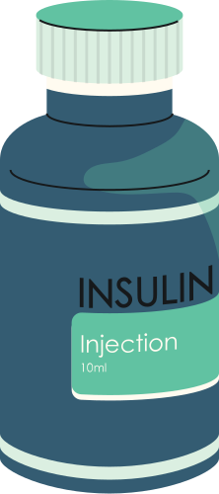
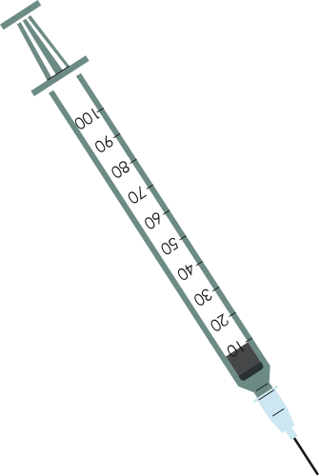




MedTrove
Development
Aliza Ibrahim 21i-0470
Kissa Zahra 21i-0572
Hamna Rizwan 21i-0603
Supervisor: Mr. Bilal Khalid Dar
Co-Supervisor: Ms. Zoya Mahboob

Slide 2













Overview
Problem Statement
Existing
Systems
Process Flow
Problem Solution
Scope
Prototype
Goals
Tools
&
Technologies
Timeline
&
Work Division
1

Slide 3


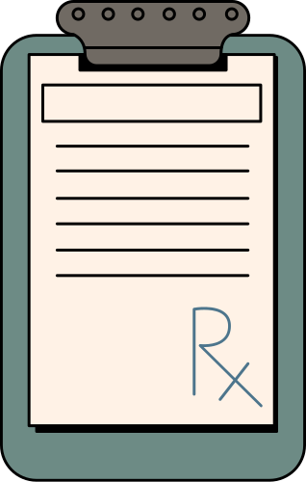
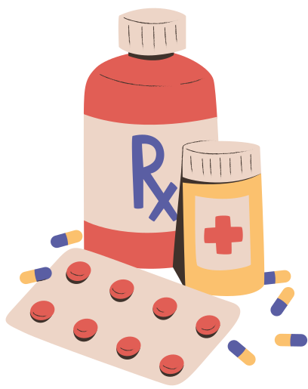

Problem Statement
Medication prices surged by up to 200% since 2019.
High prevalence of diabetes (26.7%) and heart diseases (29% of deaths).
Corruption in healthcare exacerbates affordability issues.
40% of Pakistanis live below the poverty line as of 2024.
2

Slide 4
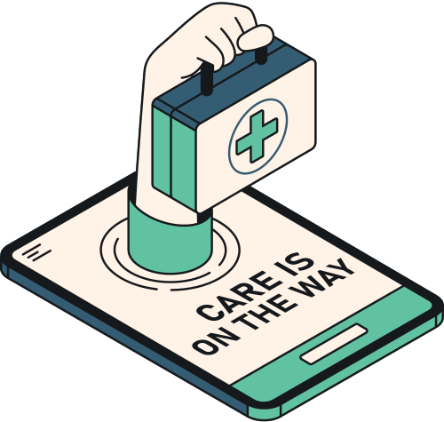
Problem Solution
MedTrove Mobile Application:
Search + Alternatives
Medibot
Online Doctor Consultations
3

Slide 5

Goals
Streamlined medication management
Informed decision making
Personalised health insights
4

Slide 6





Existing Systems
Dawaii.com
Drugs.com
Pharmapedia
5

Slide 7
Existing Systems
 | Dawaii.com | Drugs.com | Pharmapedia
Pros | Good Interface Alternative medication | Alternative medication | Alternative medication
Cons | No nearby pharmacy locator No reminder/tracker No chatbot to help simplify complex terms | Cluttered Interface No purchasing of medication No pharmacy locator | No purchasing of medications No reminder/tracker No pharmacy locator
Cons | No nearby pharmacy locator No reminder/tracker No chatbot to help simplify complex terms | Cluttered Interface No purchasing of medication No pharmacy locator | No purchasing of medications No reminder/tracker No pharmacy locator
6

Slide 8

Scope
Cross-Platform Application
User Account Management
Medication Search
Shopping Cart and Checkout
Drug Interaction Checker
Medibot
Online Consultations
Donations
7

Slide 9
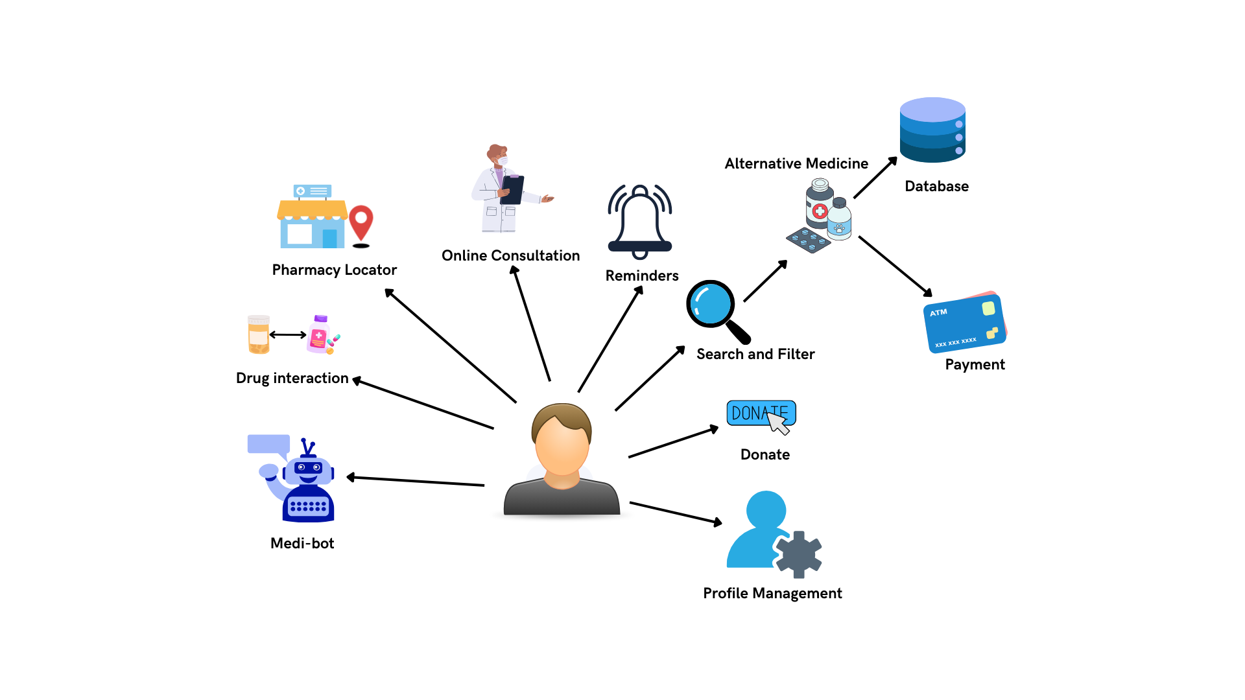
Process Flow
8

Slide 10
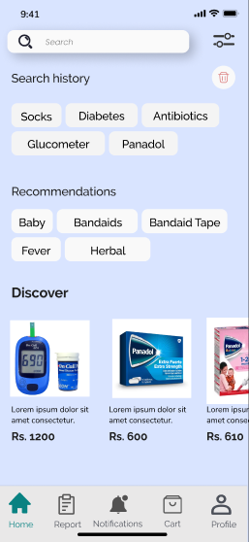
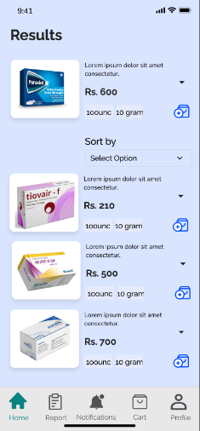
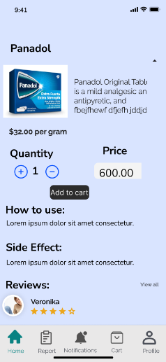
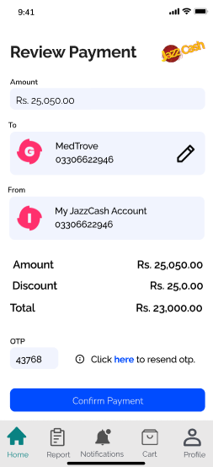
Prototype
9
Search Medicine
Alternative Medicine
Medicine Infomation
Payment

Slide 11

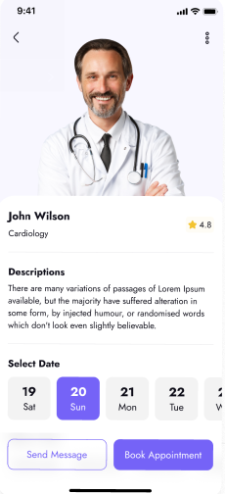
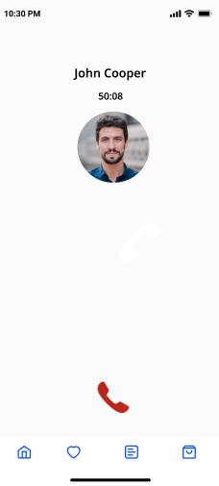
Prototype
10
Online Consultation
Doctor informatiion
Online Calls

Slide 12
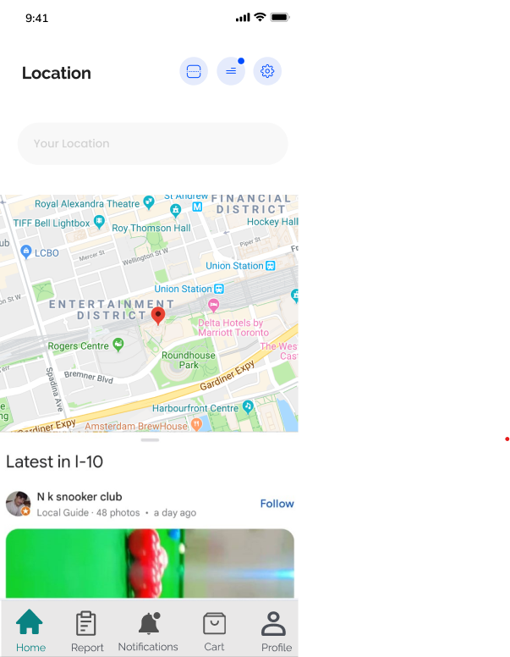
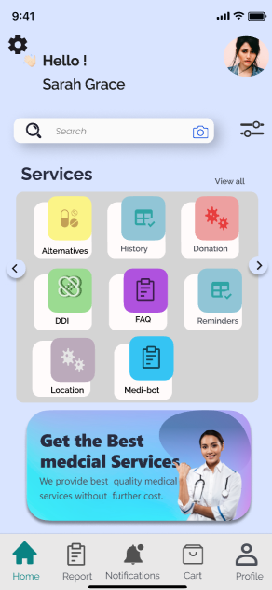
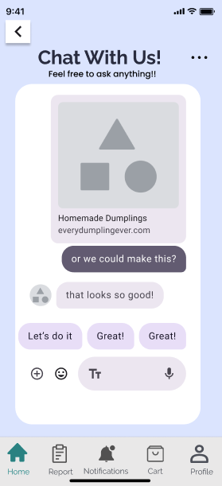
Prototype
11
Pharmacy Locator
Home page
MediBot

Slide 13







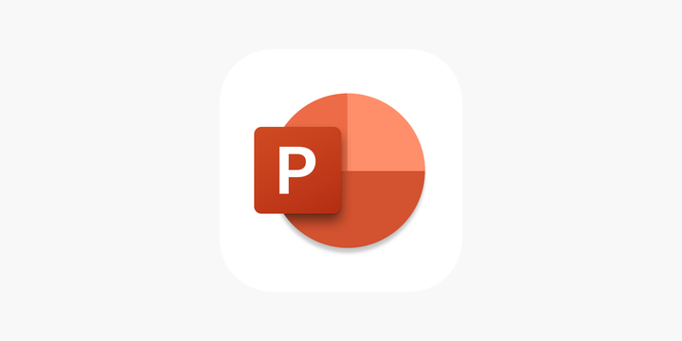



Tools and Technologies
Python
MERN
HTML/CSS/JS
Github
VS code
Android Studio
12
Figma
Trello
MS excel
Word
Powerpoint

Slide 14
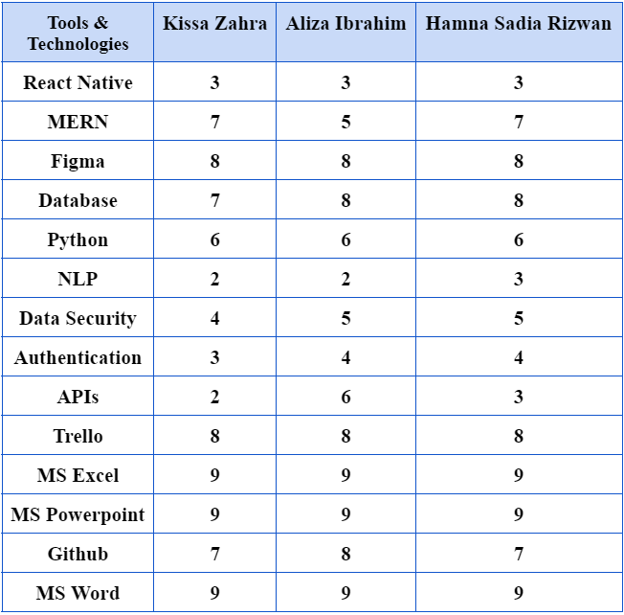
Skill Assessment
13

Slide 15
TASK / PROCESS
Iteration 1
Iteration 2
Iteration 3
Iteration 4
T
I
M
E
L
I
N
E
AUG - OCT
NOV - JAN
FEB- APR
MAY - JUL
UI/UX implementation
Learning
Identify Dataset
Substitute Drug Identifier
Drug search & Recommendation
Pharmacy Locator
Video Conferencing
Payment
Donation
Medi-Bot
Online Consultation
Drug interaction Checker
Medication Reminder
14
Profile Management
Testing & Debugging

Slide 16
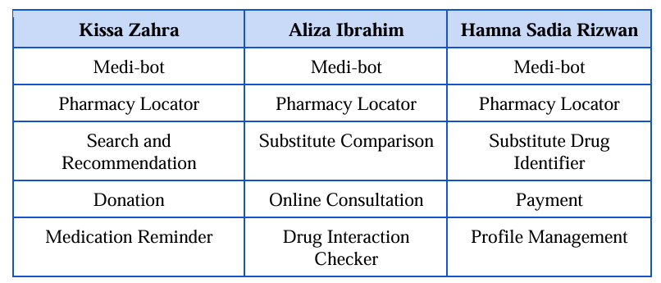
Work Division
15

Slide 17

Conclusion
16

Slide 18

References
[1] F. Durrani, “Increase in drug prices highest in last 40 years,” 8 April 2019. [Online]. Available: https://www.thenews.com.pk/print/454864-increase-in-drug-prices-highest-in-last-40-years. [Accessed 12 July 2024].
[2] “Govt approves increase in prices of 146 essential life-saving medicines,” 1 February 2024. [Online]. Available: https://www.dawn.com/news/1810395. [Accessed 12 July 2024].
[3] “The increasing rate of diabetes in Pakistan: A silent killer,” [Online]. Available: https://www.ncbi.nlm.nih.gov/pmc/articles/PMC9289249/. [Accessed 12 July 2024].
[4] I. Junaidi and R. Zakaria, “'47 people die of heart attack every hour in Pakistan',” 30 September 2021. [Online]. Available: https://www.dawn.com/news/1649189. [Accessed 12 July 2024].
[5] “PAKISTAN: Implementing an Ambitious, Credible and Clearly Communicated Economic Reform Plan Critical for Robust Recovery, Poverty Reduction, says World Bank,” 2 April 2024. [Online]. Available: https://www.worldbank.org/en/news/press-release/2024/04/01/pakistan-implementing-an-ambitious-credible-and-clearly-communicated-economic-reform-plan-critical-for-robust-recovery-p. [Accessed 12 July 2024].
[6] Dawn, “Big Pharma and Physicians,” 6 October 2008. [Online]. Available: https://www.dawn.com/news/845158/big-pharma-and-physicians.

Slide 19

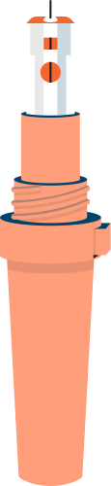
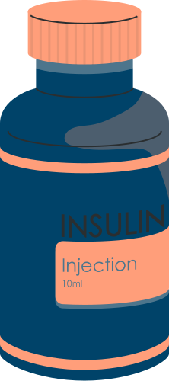
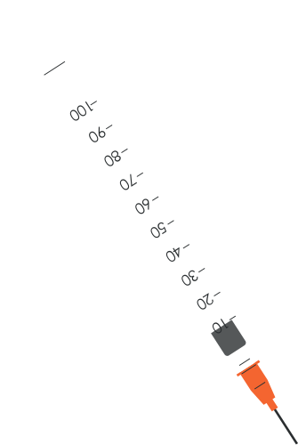

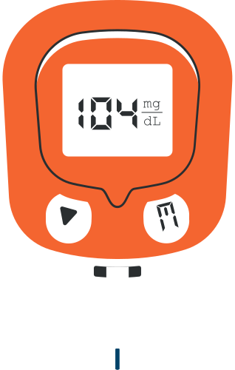
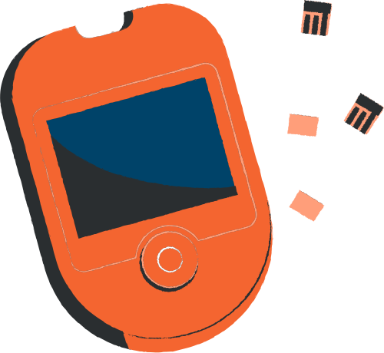
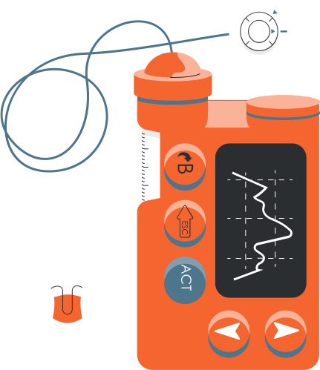

Thank You!
Any Questions?

